Slide 1
Stolen Guns Database
By: Un Hou 'Albert' Chan
Derek Delacruz
Hedi Moalla
Team #9

Slide 2
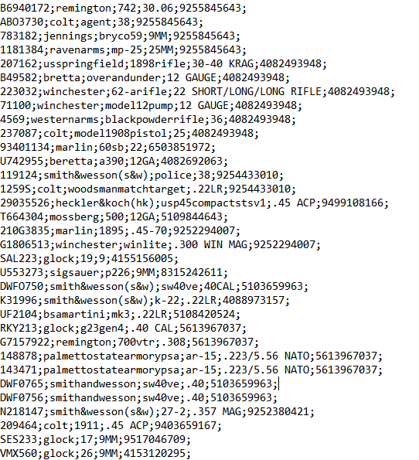
Input File
02
Text file containing stolen gun information
Serial – Primary Key
Make (Brand)
Model
Caliber
Phone Number – Secondary Key
www.hotgunzz.com
Notes:
Data was retrieved from www.hotgunzz.com

Slide 3
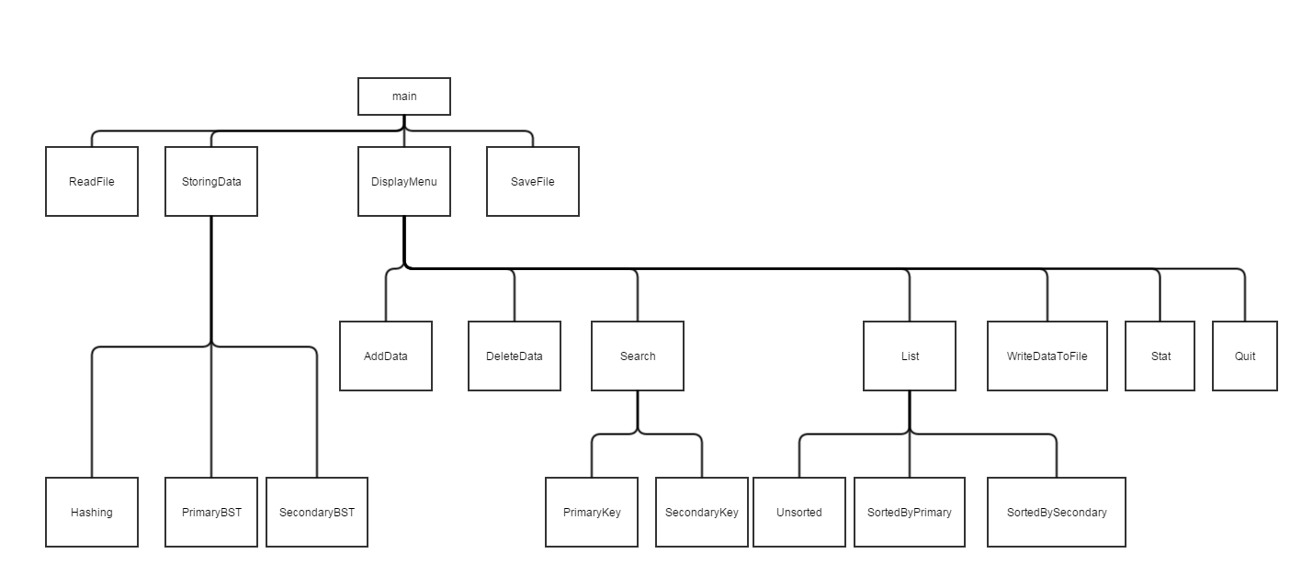
Structure Chart
03

Slide 4
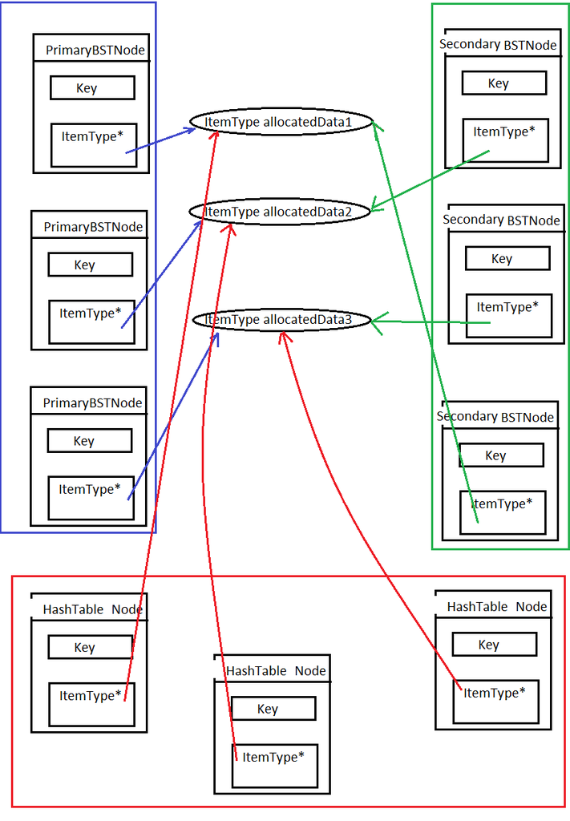
Data Structure Diagram
04

Slide 5
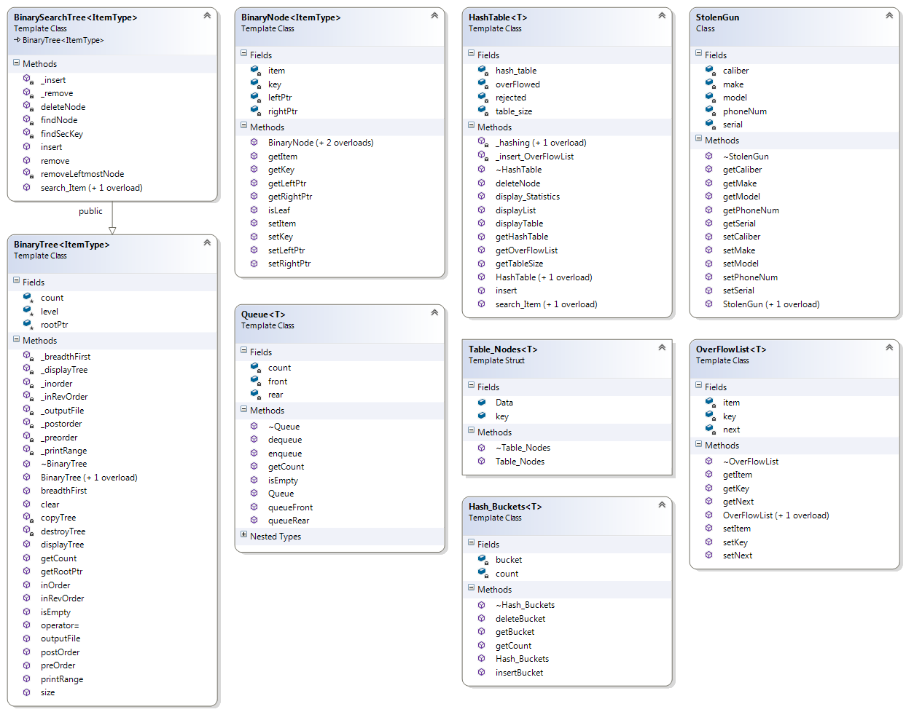
UML Diagram
01
05

Slide 6
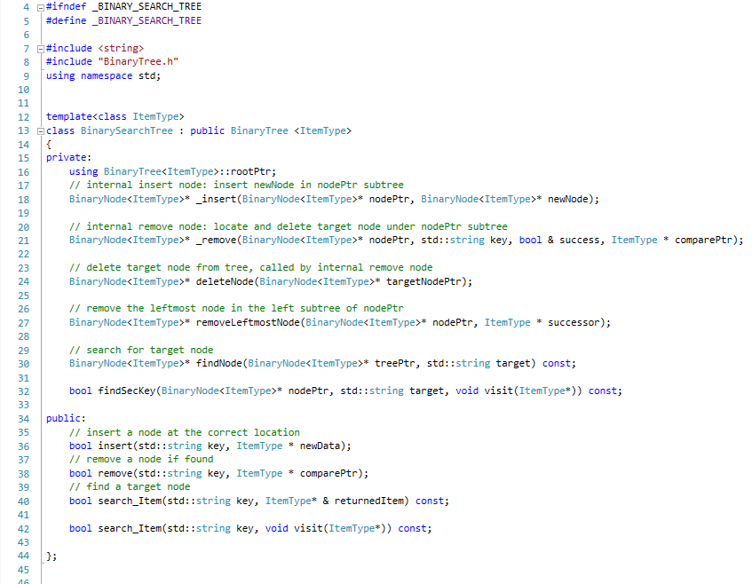
BST
01
06

Slide 7
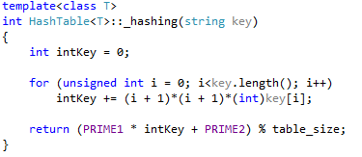
Hash
01
07

Slide 8
Collision Resolution Method
08
Bucket hashing
Overflown (rejected) items are sent to a linked list

Slide 9



Software Used
01
09

Slide 10
Members Contribution
01
10
Area | Programmer
Team Coordination BST Algorithms Screen Output UML | Hedi Moalla
Hash List Algorithms File I/O DSD Documentation | Un Hou ‘Albert’ Chan
Hash List algorithms Presentation Outline Structure Chart Documentation | Derek Delacruz

Slide 11
01
11
→ Demonstration

